Slide 1



Digital Performance Platform
A unified intelligence portal bringing real-time visibility into athlete management, federation governance, event operations, and national sports budget — powered by AI.

Slide 2
The Vision
Transforming Kuwait's sports ecosystem through a centralized digital command center
1
Centralized Data
2
Real-Time Intelligence
3
AI-Powered Insights
All 8 critical modules — from athlete registration to budget allocation — unified in one portal. No more siloed spreadsheets or disconnected reports.
Live KPIs, trend analysis, and automated anomaly detection keep leadership informed at every level — executive, federation, and ground operations.
A conversational AI Hub lets decision-makers query any metric in natural language — getting instant answers without navigating complex dashboards.

Slide 3
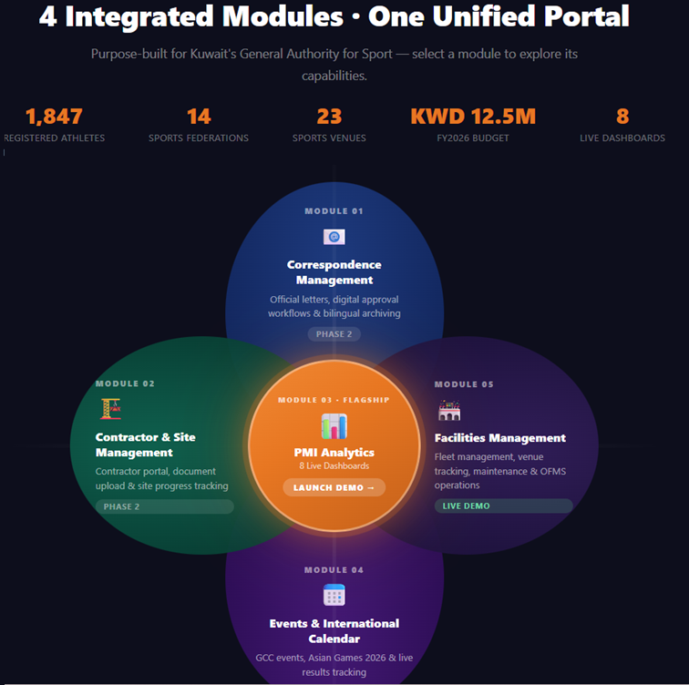
The Portal

Slide 4
8 Integrated Modules
Each module is purpose-built for a specific domain of national sports governance
1
Executive
2
Athlete Management
High-level KPI overview, cross-module summaries, and leadership reporting
Registration, performance tracking, career history, and medical records
3
Federation
4
Youth Development
Federation compliance, governance metrics, and organizational health
Youth programs, school partnerships, grassroots participation stats
5
Anti-Doping
6
Facilities
Test scheduling, compliance rates, violation tracking, WADA alignment
Venue utilization, maintenance schedules, capacity planning
7
Events
8
Budget & Finance
Event calendar, participation tracking, logistics, and results
Allocation tracking, spending vs. budget, quarterly forecasting

Slide 5
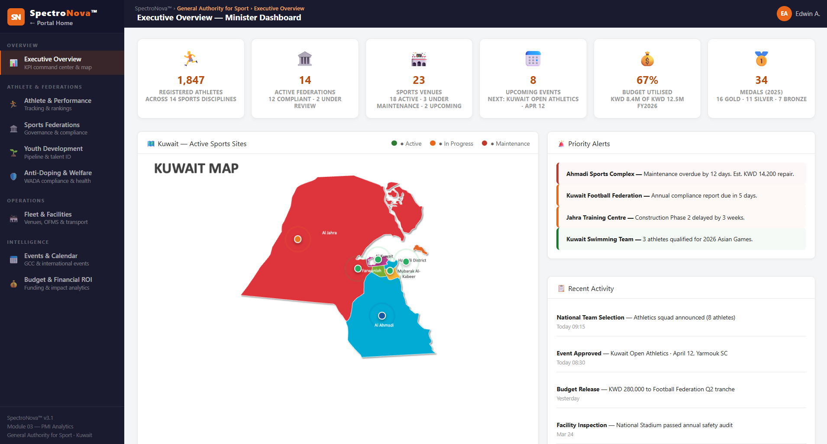
Executive Dashboard
Real-time KPIs, charts, and activity tracking at a glance

Slide 6
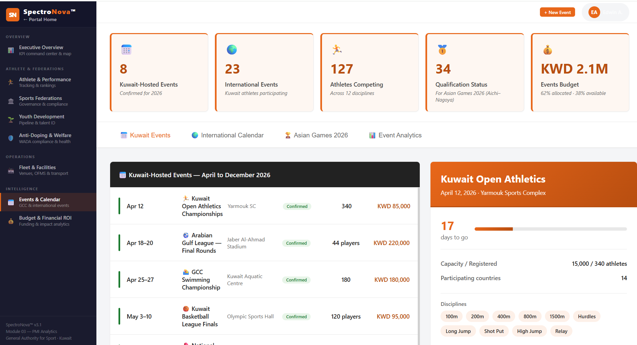
Events and Calendar
Real-time KPIs, charts, and activity tracking at a glance

Slide 7
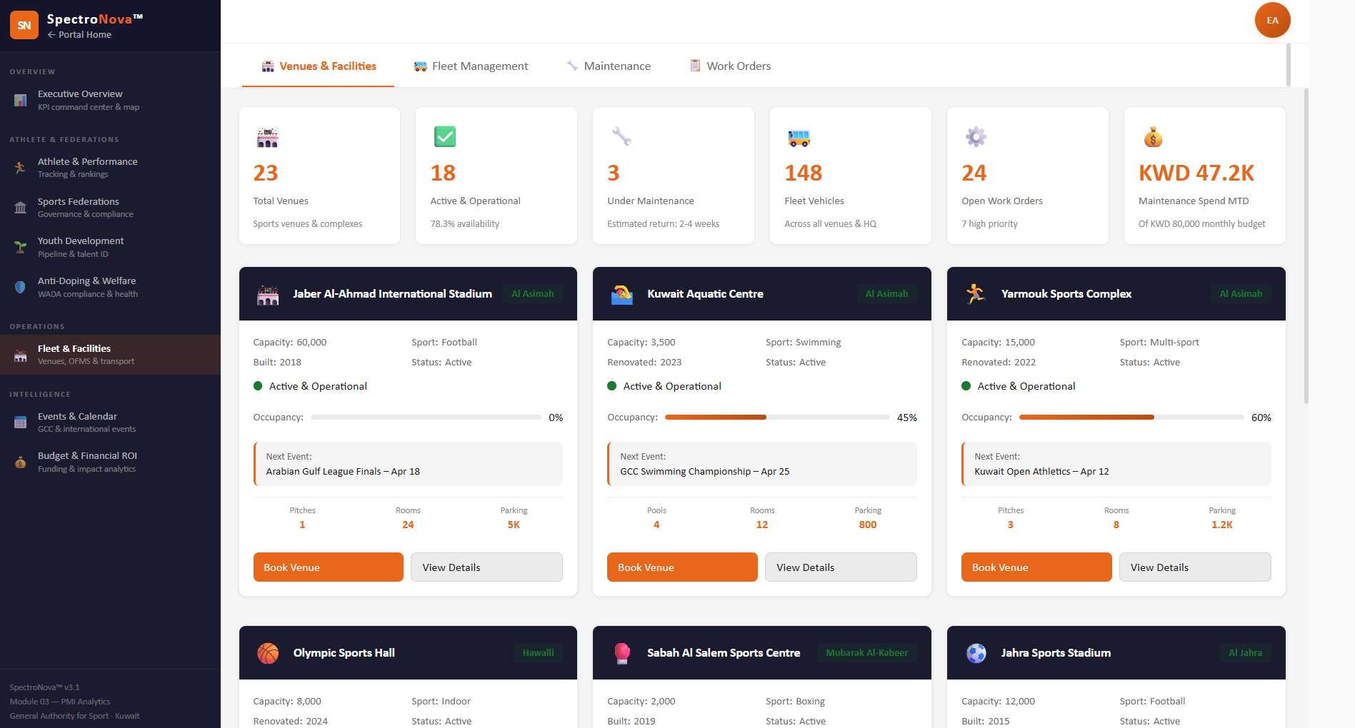
Facilities and Fleet Management
Real-time KPIs, charts, and activity tracking at a glance

Slide 8


What the AI Chat Can Do
SpectroNOVA Chat AI Hub — Live Conversation
Your entire sports data ecosystem, accessible through conversation
What's our budget utilization?
Budget utilization is at 78% with 3 months remaining.
Facilities: 92%
Training: 68%
Events: 71%
1
Natural Language Queries in ARABIC
Ask "How many athletes registered in Q1?" and get instant, accurate answers with supporting data.
Flag anything over 85%
2
Cross-Module Intelligence
⚠ Facilities maintenance is at 92% — 15% over projection. Recommend reallocation review.
The AI connects data across all 8 modules — correlating budget spend with athlete performance, or facility usage with event outcomes.
3
Anomaly Detection
Proactive alerts when metrics deviate from expected patterns — like a sudden drop in youth registrations or unexpected budget overruns.

Slide 9
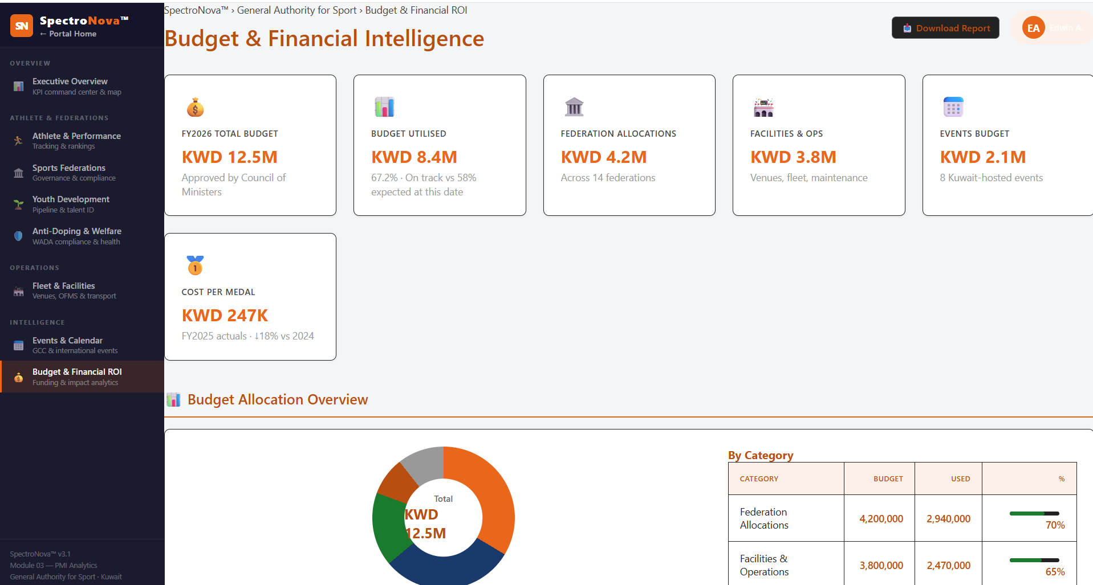
Budget and Actual Comparison
Real-time KPIs, charts, and activity tracking at a glance

